Slide 1






Embrace Technology, Engage as an Active Citizen
Our project logo
2024-1-DE04-KA154-YOU-000238751
Embrace Technology, Engage as an Active Citizen
01/10/2024
8 months
31/05/2025

Slide 2
Our general goal is to ensure that young people are proficient in digital tools in today's technology age, participate in policy-making processes, influence decision-makers, and are knowledgeable about their rights and responsibilities in the digital world. A youth participation program that will be implemented in this context will be one of the most effective ways to achieve this goal.
Specific Objectives:
● To raise awareness among young people about media literacy, access to accurate information and data verification.
● To inform young people about human rights, and motivate them to defend their rights using digital tools, both at the local and European level.
● To educate young people about participation in democratic life and policymaking processes using digital tools, teaching them about their responsibilities and best practices.

Slide 3
Partners
Phoenix Knowledge Wings gGmbH (E10344237, DE) Germany Applicant Organisation Non-governmental organisation/association
Changemakers Debrecen (E10347018, HU)
Hungary Partner Organisation Youth organisation The Changemakers (E10101273, TR) Türkiye Partner Organisation Group of young people
Eurostar Group (E10136089, RO) Romania Partner Organisation Group of young people

Slide 4
Who will participate?
Youth participation events with mobilities 66
Youth participation mobilities 40
Participants not taking part in an Activity or Event 800

Slide 5
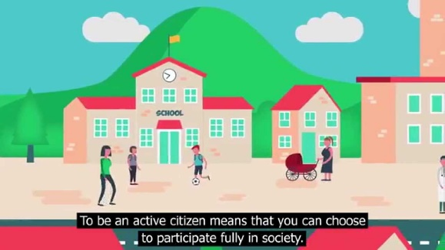
What is Active Citizenship?
Active Citizenship is the philosophy that citizens should work toward the improvement of their community, through economic participation, public volunteer work, and other such efforts to improve life for all citizens.
Democracies need active, informed and responsible citizens; citizens who are willing and able to take responsibility for themselves and their communities and contribute to the political process.
An effective Active Citizen is a person who understands the obligation and undertakes the responsibility to improve community conditions, build healthier communities and address social problems.

Slide 6
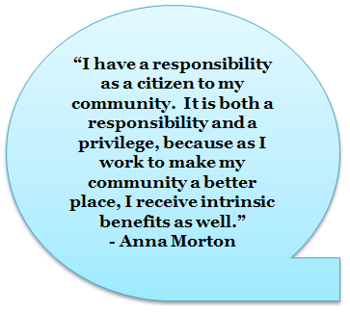
Active Citizenship
Active Citizens don’t expect the government to solve every problem
They want to engage within the government systems, with the support of governing agencies, to mutually solve problems and improve community life
Citizens have rights AND responsibilities – it’s our country too!

Slide 7

Volunteering
Help out in the community
Projects that improve life
Lend your expertise to those who can’t afford it
Many hands make light work

Slide 8
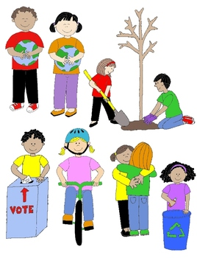
Active Citizenship
Active Citizenship brings people together
Counters the isolation of the Internet
Allows for discourse
Brings out our similarities, makes us realize our differences are minor

Slide 9
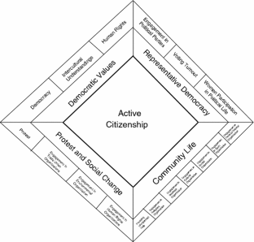
4 Dimensions of Active Citizenship
Protest and Social Change
  Petitions, demonstrations, boycotts, political engagement
  Human Rights & Environmental Organizations, Unions
Community Life
  Religious organizations, Business, Cultural & Social Groups
  Sports, PTA
Representative Democracy
  Political Parties, Voting, Community-level Politics
Democratic Values
  Democracy, Intercultural Understanding,
  Human Rights

Slide 10


Summary of Active Citizenship
Active Citizens are those who develop the skills, knowledge and understanding to be able to make informed decisions about their communities and workplaces with the aim of improving the quality of life
An active citizen may challenge the rules and existing structures although they should generally stay within the bounds of democratic processes and not become involved in violent acts
Active Citizens value respect, courage, openness, tolerance, listening, working
Active Citizens participate in the community (involvement in a voluntary activity or engaging with local government agencies)

Slide 11
Summary of Active Citizenship
Active Citizens are empowered to play a part in the decisions and processes that affect them, particularly public policy and services
Active Citizens have knowledge and understanding of the political/social/economic context of their participation so that they can make informed decisions
Active Citizens are able to challenge policies or actions and existing structures on the basis of principles such as equality, inclusiveness, diversity and social justice
Democracies need active, informed and responsible citizens who are willing and able to take responsibility for themselves and their communities and contribute to the political process

Slide 12

Summary of Active Citizenship
Democracies depend upon citizens who are
  Aware of their rights and responsibilities as citizens
  Informed about the social and political world
  Concerned about the welfare of others
  Articulate in their opinions and arguments
  Capable of having an influence on the world
  Active in their communities
  Responsible in how they act as citizens

Slide 13

Summary of Active Citizenship
Citizenship issues are
  Real: they actually affect peoples’ lives
  Topical: current today
  Sometimes Sensitive: can affect people at a personal level, especially when family or friends are involved
  Often controversial: people disagree and hold strong opinions about them
  Ultimately moral: relate to what people think is right or wrong, good or bad, important or unimportant in society

Slide 14
Summary of Active Citizenship
Active Citizenship helps young people
  to develop self-confidence and successfully deal with significant life changes and challenges such as bullying and discrimination
  by giving them a voice in the life of their schools, communities, and society
  to make a positive contribution by developing the expertise and experience needed to claim their rights and understand their responsibilities and preparing them for the challenges and opportunities of adult and working life

Slide 15
Citizenship Education
Essential elements of citizenship education are:
  Knowledge and understanding about topics such as
    laws and rules
    the democratic process
    the media
    human rights diversity
    money and the economy
    sustainable development
    the world as a global community
    concepts such as democracy, justice, equality, freedom, authority, and the rule of law

Slide 16
Citizenship Education
Essential elements of citizenship education are:
  Skills and aptitudes:
    Critical thinking
    Analyzing information
    Expressing opinions
    Taking part in discussions and debates
    Negotiating
    Conflict resolution
    Participating in community action

Slide 17
Citizenship Education
Essential elements of citizenship education are:
  Values and dispositions:
    Respect for justice, democracy and the rule of law, openness, tolerance, courage to defend a point of view
    Willingness to listen to, work with and stand up for others

Slide 18

Topics Good Citizens Know:
Laws and rules
Voting for government office
Role and influence of the media
Human rights
Cultural diversity
Money and the economy
The environment and sustainable development
Concepts such as democracy, justice, equality, freedom, authority, and the rule of law

Slide 19


Characteristics of Active Citizenship
The Junior Chamber International (JCI) lists the following characteristics of active citizenship:
Respect
Honoring duties
Being informed
Compassion
Active Involvement
Working together
Sustainable solutions
Self-development
Safe, stable and clean environment

Slide 20
Tips for Active Citizens
Take only positive positions
Listen to all peoples’ views
Avoid stereotyping
Accept responsibility – don’t blame others for a lack of success
Be persistent
Act
Keep an ongoing assessment
Celebrate milestones along the way to maintain motivation

Slide 21
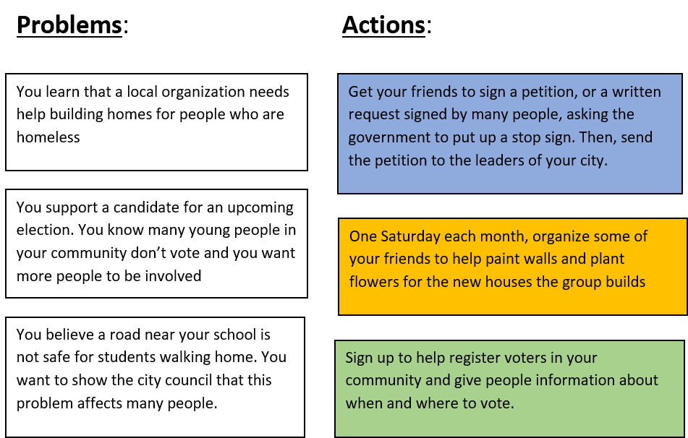
Practical Exercise
Match each problem with an action you could take in response.

Slide 22
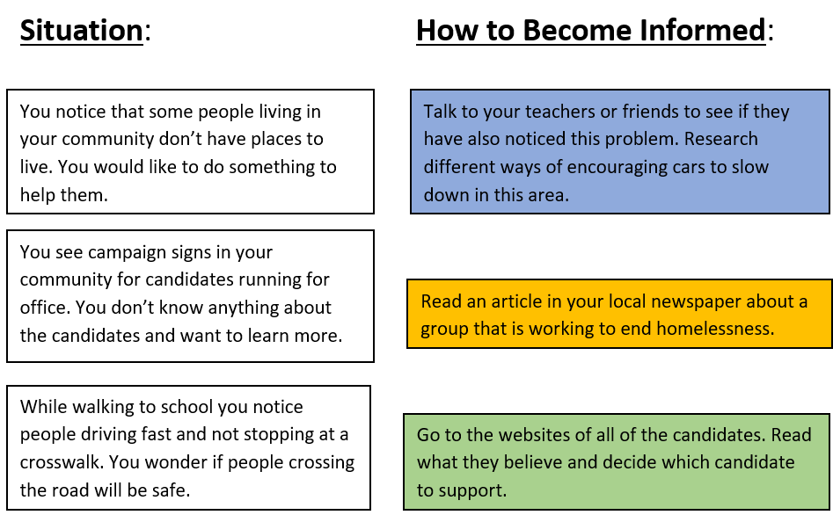
Practical Exercise
You might notice issues that you want to learn more about in your community. Imagine you are in the situations below. Match each situation with the steps you could take to become more informed.

Slide 23
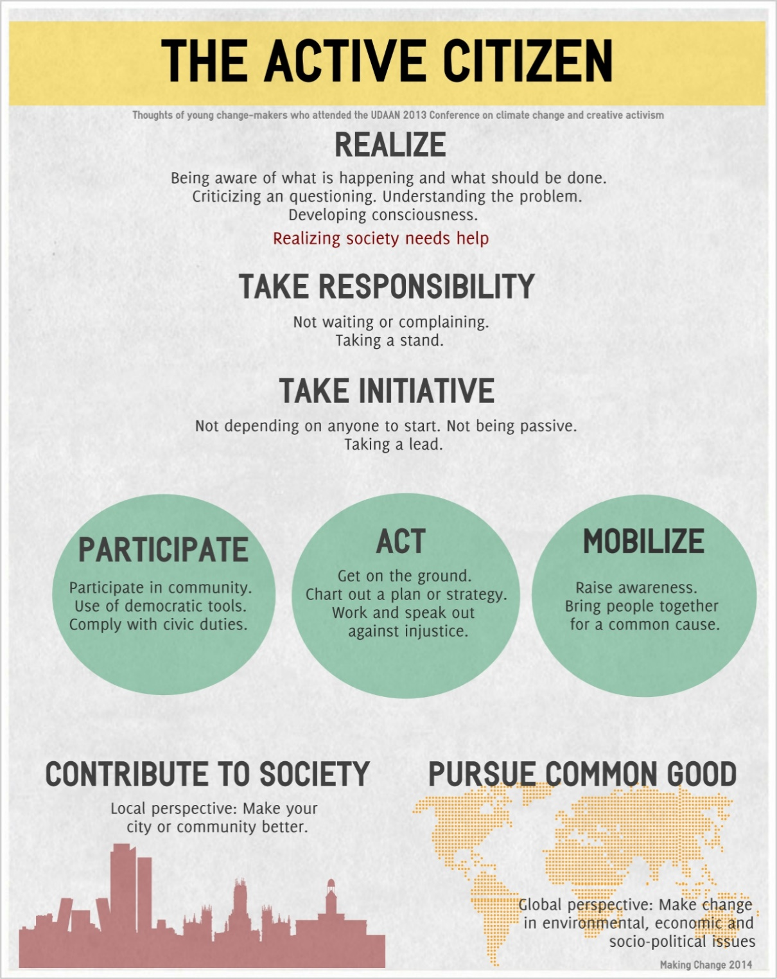

Slide 24
Models for Active Citizenship
OBJECTIVES:
DESIRED OUTCOME (Leadership)
Cadets will embrace their role as Active Citizens.
Plan of Action:
Explain two Active Citizenship Models
Essential Question:
What are the processes identified in an Active Citizenship model?

Slide 25
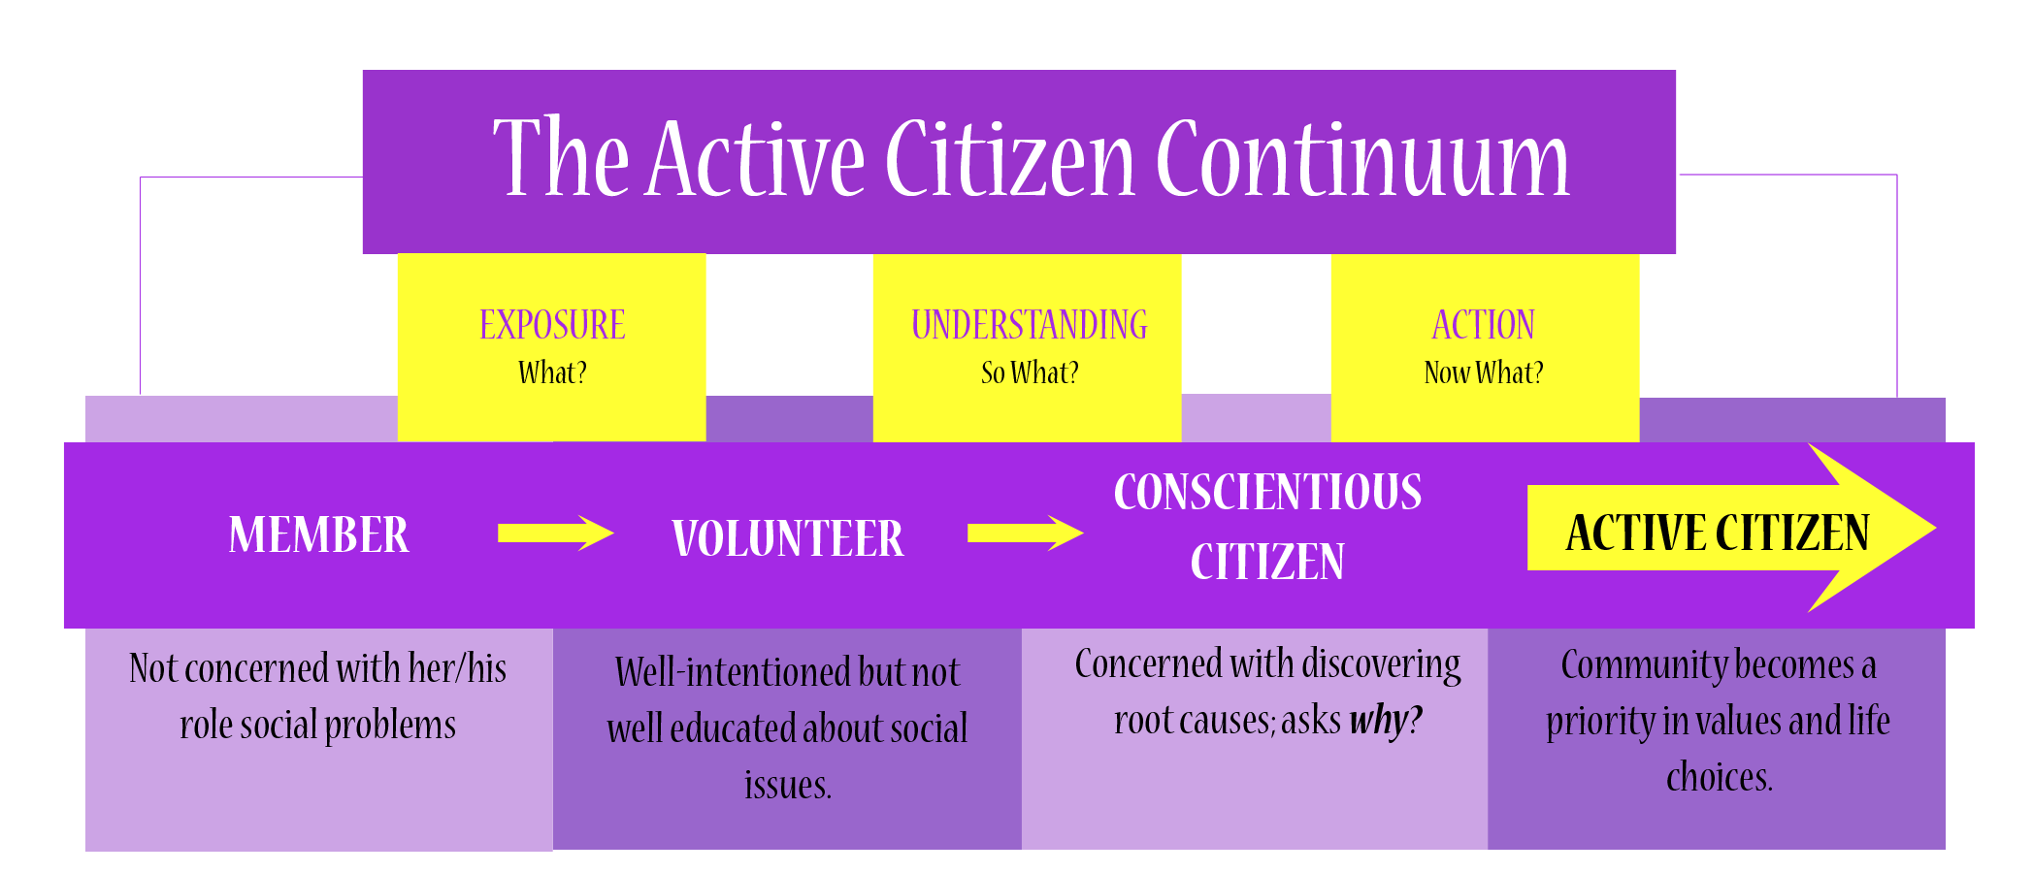
Model for Active Citizens
Where are you on this continuum?

Slide 26
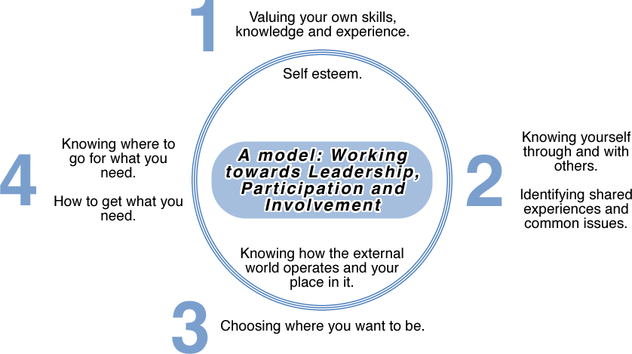
“Take Part” Model

Slide 27
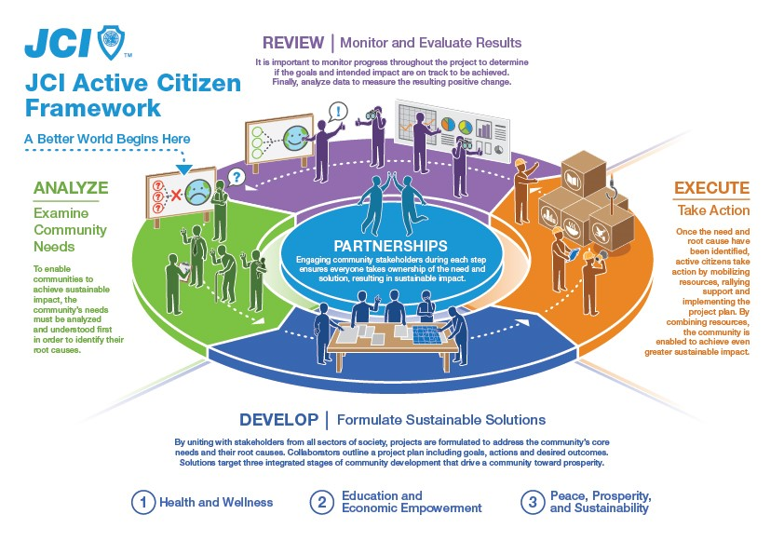
JCI Framework / Model

Slide 28
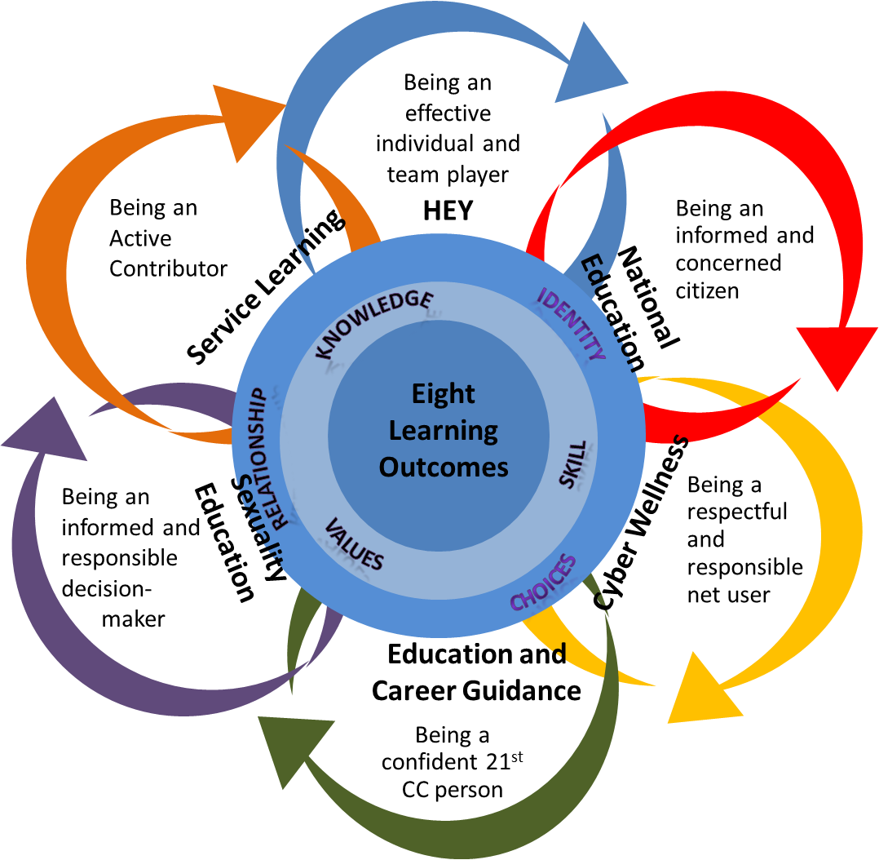
Learning Outcomes of
Character & Citizenship Development Model

Slide 29
Be an Active Citizen!
Can you use the leadership skills you have learned in Cadet Corps and put them to use in other parts of your life?
These models suggest that you can.
If you want to be a contributing citizen of your community, California, the United States, and the World, you must be involved in issues that are important to you.
A leader has an impact on others; as an active citizen, you can spread that impact, potentially around the world!

Slide 30
Active Citizenship Self-Assessment
OBJECTIVES:
DESIRED OUTCOME (Leadership)
Cadets will embrace their role as Active Citizens.
Plan of Action:
Take an Active Citizen self-assessment
Essential Question:
How good of an Active Citizen am I now?

Slide 31
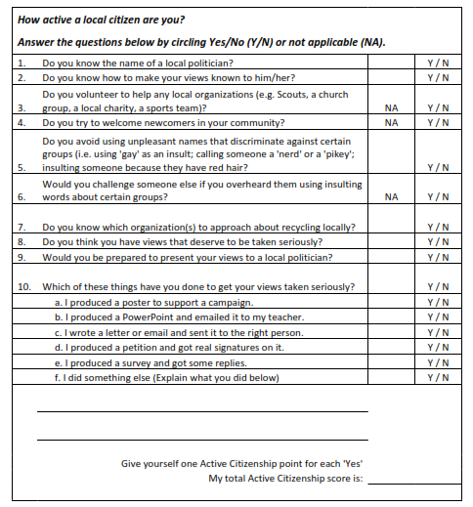
Take the Self Assessment

Slide 32
Use the Self-Assessment
What was your Active Citizen score from the Assessment?
Likely not (yet) very high
That’s okay!
How can you be a more Active Citizen?
  What actions that were listed on the Assessment could you do?
  Can you think of an issue to address in your school or community?
  Get involved!
  Earn community service points for your ribbon!

