Slide 1


active yourope
ASSOCIATION
https://www.activeyourope.ro/
Craiova, Romania

Slide 2



Mission
Our mission is to shape the future through education and community engagement, providing personal and professional development opportunities for all ages.
Our association is dedicated to providing educational initiatives aimed at improving knowledge and skills for all age groups. We strongly believe that continuing education is essential for the personal and professional development of each person, which is why we focus our efforts on creating varied and accessible programs for all members of the community.

Slide 3

Our main aims and activities are:
We offer various educational initiatives designed to improve knowledge and skills for all age groups.
We develop and implement special programs for senior adults, designed to improve their quality of life. These activities include continuing education courses, personal development workshops, and social events, which contribute to maintaining mental and physical activity, and combating social isolation.
We promote non-formal education as a tool for personal and professional development.
We believe in the power of young people to be agents of change in society.
We facilitate international mobility for young people through the Erasmus+ program.

Slide 4

The Association provides education and training services in the field of civic education, social inclusion, climate change, financial education, and social entrepreneurship.
We conducted interactive events on health education and prevention activities in order to help youths better understand and label emotions, control aggressive impulses, experience empathy, and nonviolently communication
We held workshop regarding the management of a NGO, development of a NGO, writing projects, about the tools of fundraising
Activities for Seniors: Learning, Socializing and Physical & Mental Well-being

Slide 5

we conduct 2 studies in collaboration with teachers from Faculty of Stomatology Craiova “Education for oral health. Research on dental and maxillary anomalies and dental-periodontal lesions to children from Oltenia region ".
During this study, we provided information regarding oral health to children 6-14 years old.

Slide 6

Erasmus+ training courses provider
Active Yourope Association is a leading adult education provider specializing in Erasmus+ training courses for teachers, youth workers, VET educators, and adult education staff . Our mission is to enhance teaching strategies, promote innovative learning, and provide professional development opportunities for educators across Europe .
All our Erasmus+ training courses are eligible for Erasmus+ funding under the Key Action 1 (KA1) mobility program of the European Commission .
https://www.activeyourope.ro/cursuri/

Slide 7
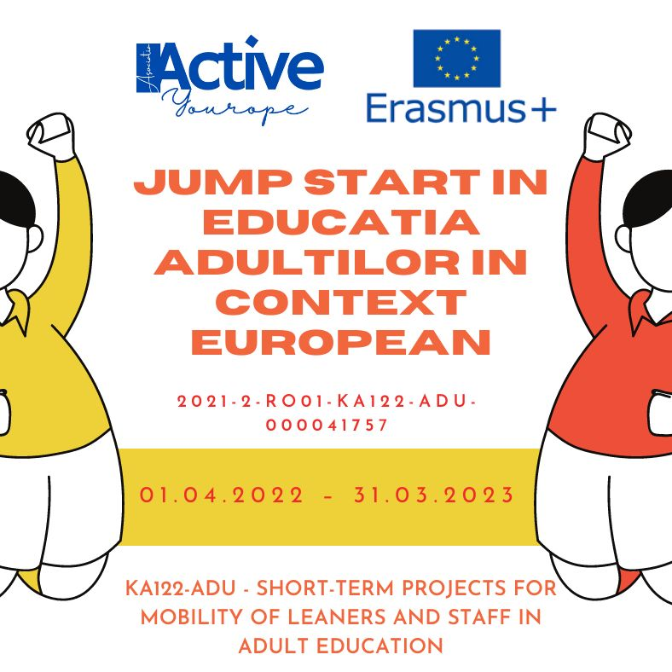
Adult Field
Erasmus+ PROJECTS
Jump Start in adults' education in European context,
Erasmus + project number 2021-2-RO01-KA122-ADU-000041757

Slide 8
Project implementation period: April 1, 2022 – March 31, 2023
The project objectives are:
Improving the digital skills of trainers and association members through the participation of 2 people in European training courses during the 12-month project.
Developing the transversal skills of members through the participation of 3 trainers in European mobilities regarding the use of new teaching strategies for educating vulnerable groups during the 12-month project.
Increasing managerial skills and strengthening cooperation with European partners in the field of adult education through the participation of 2 members of the association in a job-shadowing.

Slide 9

Erasmus+ Accreditation in the Field of Adult Education 2023-2027
number 2022-1-RO01-KA120-ADU-000110917.
Accreditation Objectives
Diversifying the curriculum and educational offer in order to attract students and improve educational conditions by promoting a culture of quality.
Developing the digital skills of trainers and association members with the aim of increasing the performance and efficiency of teaching activities.
Developing key and transversal competencies of the association's members and trainers.
https://www.activeyourope.ro/proiecte-asociatie/acreditare-erasmus-2023-2027/

Slide 10
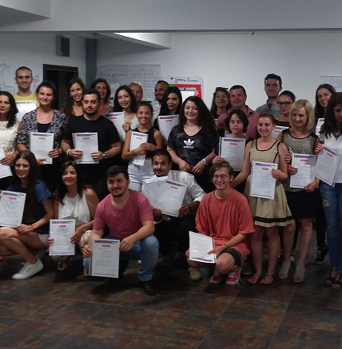
Youth Field
Social Entrepreurship for young NEETs”
Mobility of youth workers 2017-3-RO01-KA105-047092
09th July — 16th July 2018 Craiova, Romania
Improve the knowledge and skills of 36 participants to address the issue of youth unemployment among Neets persons to create a good environment of cooperation, creativity by sustaining social bussines by offering quality activities for young people to enable them to develop competence in social entreprenueurship

Slide 11
Other types of projects

Slide 12
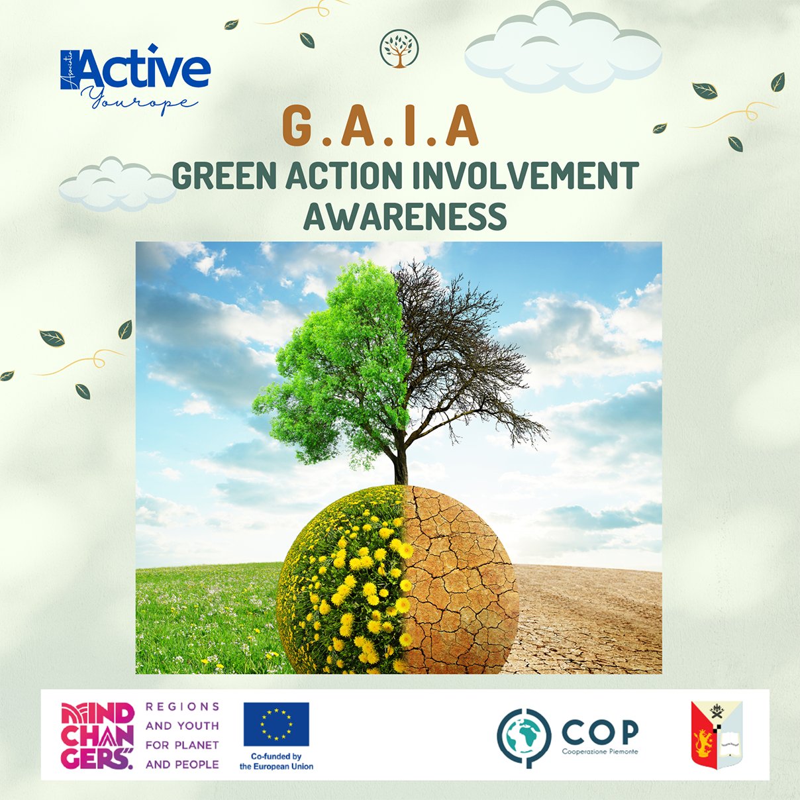
The project is primarily aimed at young people from Dolj County through their active involvement in the fight for environmental protection, but also at all citizens who wish to join our effort.
Beneficiaries: 120 young people, 30 teachers from Dolj County.
Implementation period 01.11.2022 – 01.12.2023
The project is co-financed by European funds through the Consortium of Piedmontese NGOs, within the framework project "Mindchangers – Regions and youth for Planet and People" (CSO-LA/2020/415-010).
https://www.facebook.com/GAIAGreenAwareness/

Slide 13

IRAD –Get involved responsibly, act and decide!
The project is implemented by Active Yourope Association in partnership with Icelandic Human Rights Centre, through Active Citizens Fund Romania, programme funded by Iceland, Liechtenstein, and Norway through the EEA Grants 2014 -2021.
The project consists of the implementation of activities of civic implication and education in 2 communities from Dolj county, with a high marginalization rate and with insufficiently served areas where there was a lack of civic spirit among young people, a lack of practical approach to teaching civic education and misinformation online.
Target groups:
500 young people aged 15-22
60 teachers
10 members of the association who will benefit from a training session
Aim
Increasing the degree of civic involvement and voting participation among young people by providing access to correct and true information in the online environment and by simulating and implementing civic activities for the development of the local community

Slide 14

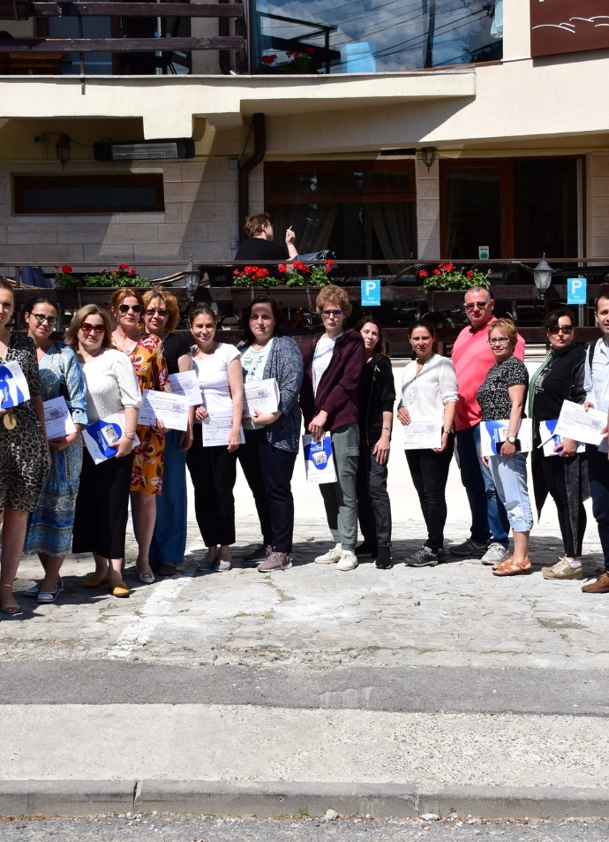

Slide 15
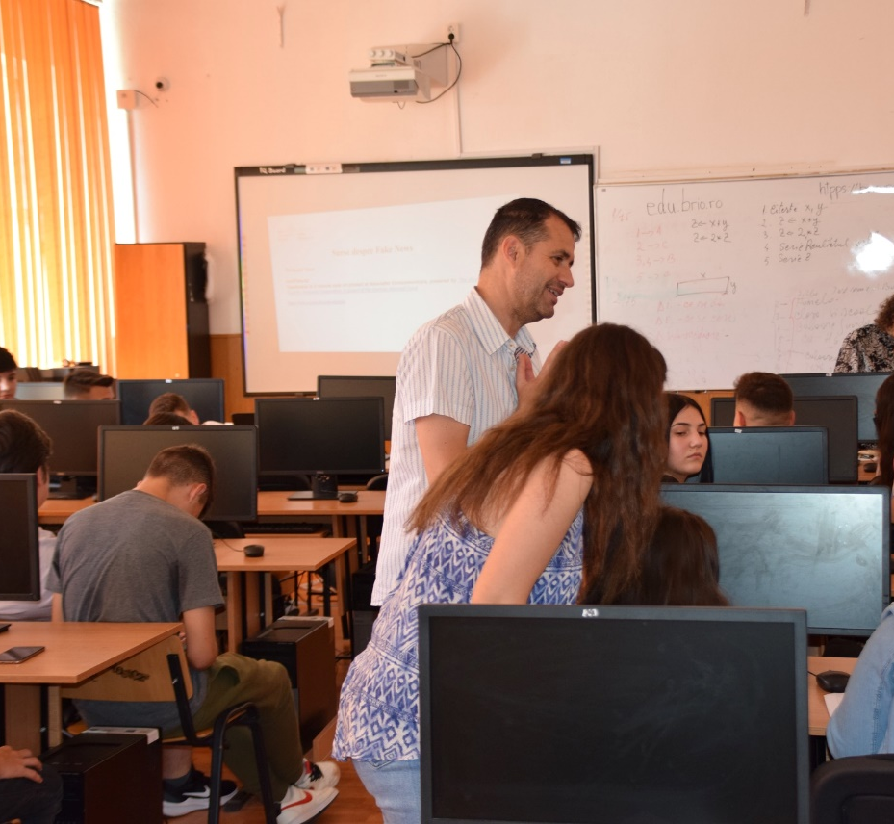
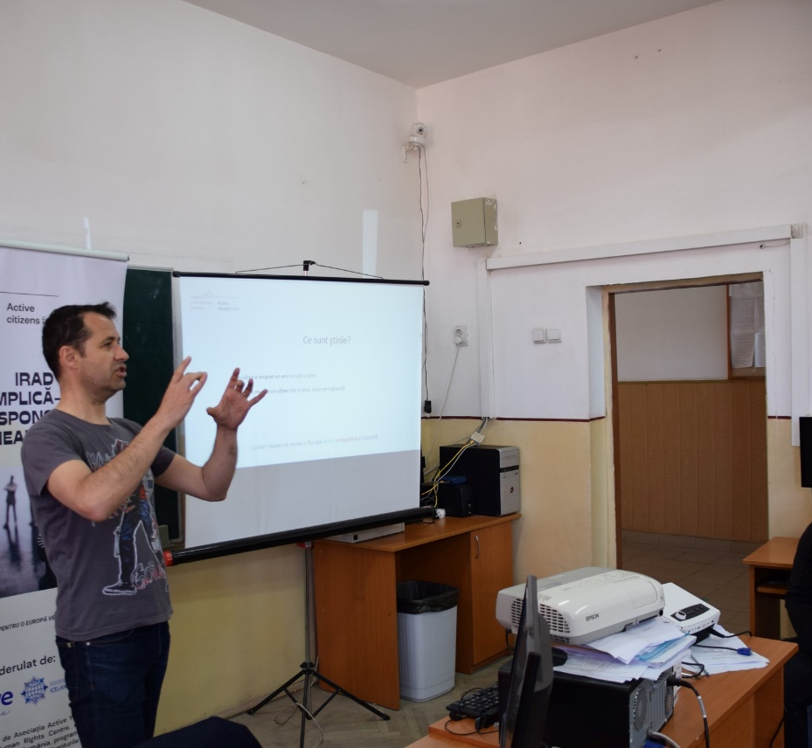
Media Literacy and fake news campaign

Slide 16
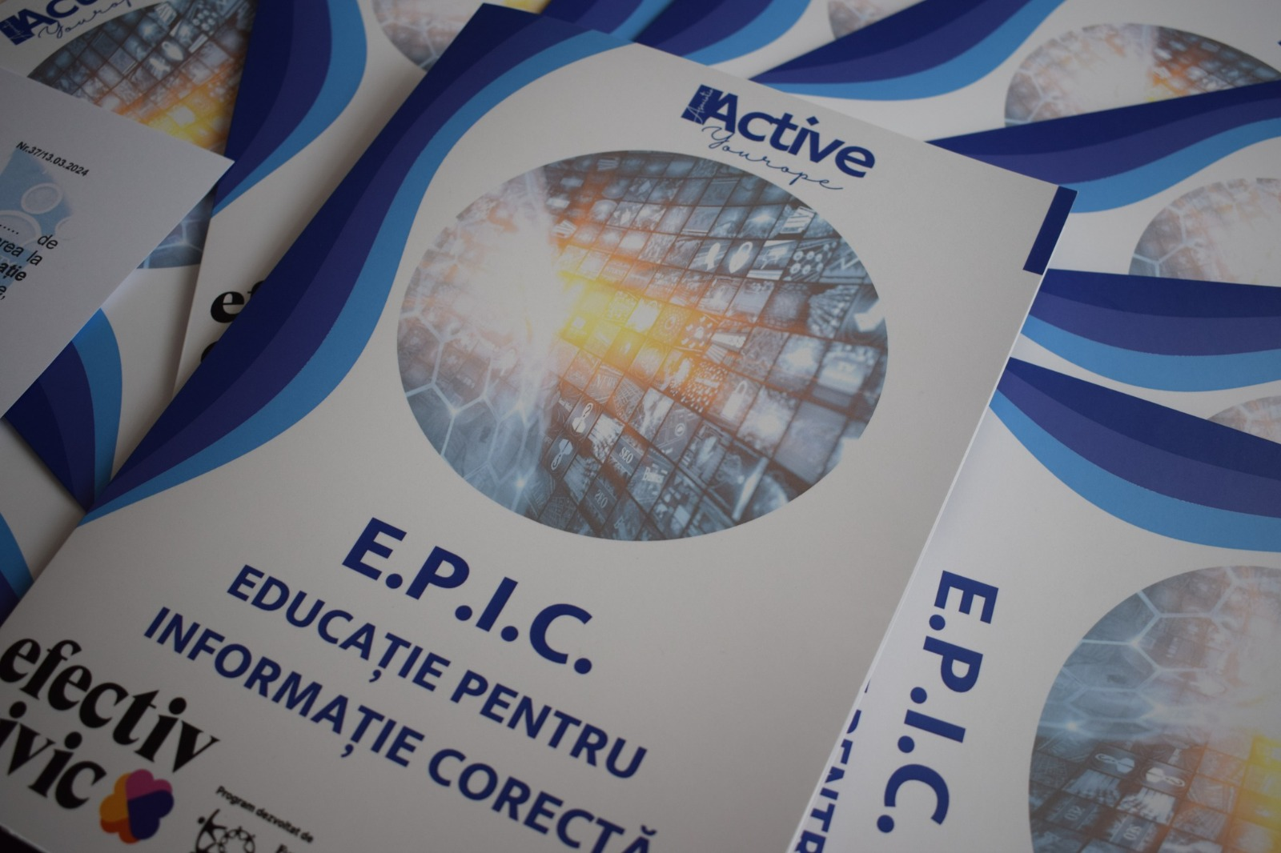
Education for Correct Information
The EPIC project – Education for Correct Information is funded by the Effective Civic program, developed by FDSC – Foundation for Civil Society Development in partnership with RAF – Romanian American Foundation and with the support of CJI – Center for Independent Journalism.
Period: February 15- August 15, 2024
The target group is 800 young people between the ages of 14 and 19 from urban and micro-urban Dolj county.
The EPIC project aims to develop the skills and knowledge of young people to become critical consumers of information, able to recognize and counter disinformation and fake new

Slide 17

Contact
https://www.activeyourope.ro/
https://www.facebook.com/asociatiactiveyourope
https://www.instagram.com/asociatia_active_yourope/

